Slide 1


Slide 2

Business Applications
Since June 2018
Independent Contractor +1 Year
Full-Stack .Net Dev
Since May 2015
Project Based
Since 2003
VB6, ASP and Javascript

Slide 3

Agenda
TDD
Why Test-Driven Development
FakeXrmEasy to the Rescue
DEMO
Plugin
Plugin Tests
Custom Workflow Action
Custom Workflow Action Tests
Unit Test Coverage report

Slide 4
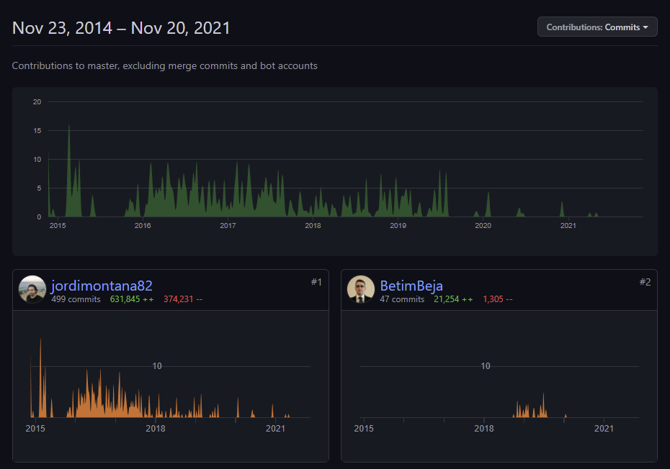
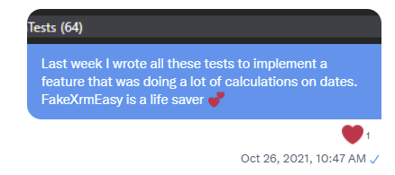
Test-Driven Development
WHY
Gives the developer more confidence
Most of the requirements can be mapped to unit tests and validated
Tests can be run in a Continuous Integration Pipeline
Best type of documentation for developers
HELP
Seven years ago… FakeXrmEasy to the rescue
Open Source with 1800+ tests that can be used as inspiration for beginners

Slide 6

Thank You

